Slide 1







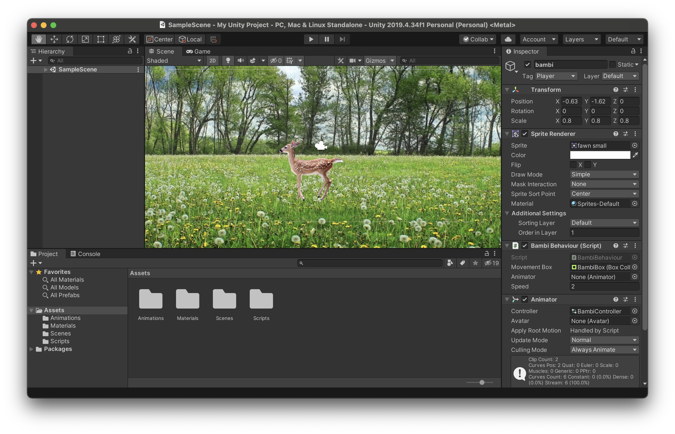

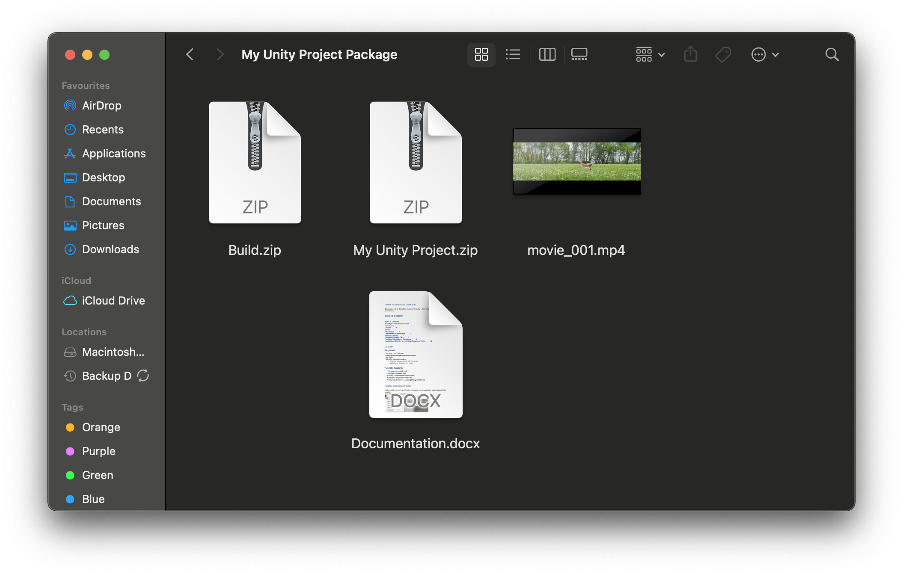

Slide 2
Simple procedure
any student can follow

Slide 3
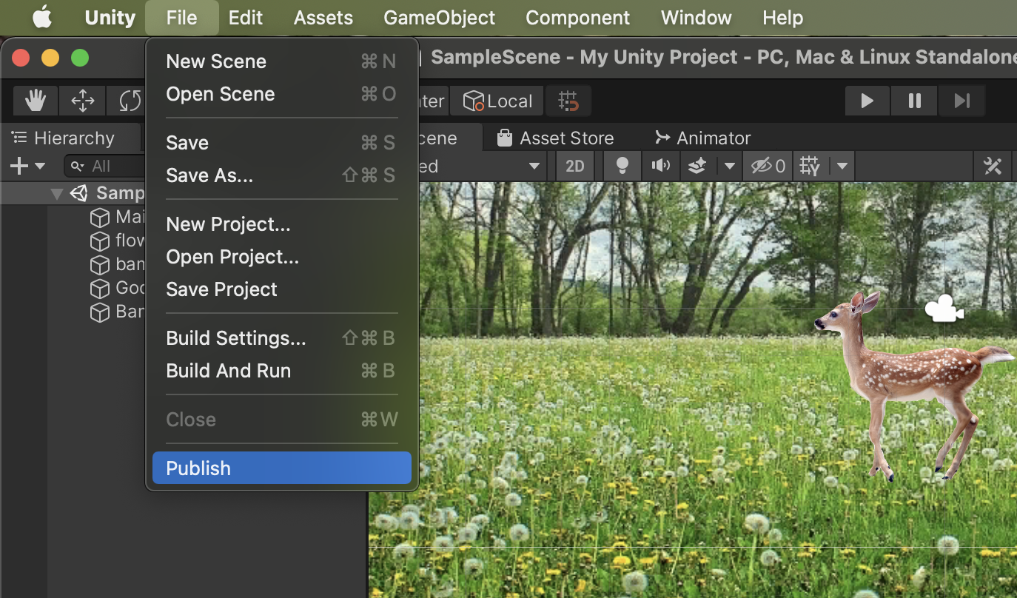
One-click publishing

Slide 4
Files ready to upload

Slide 5
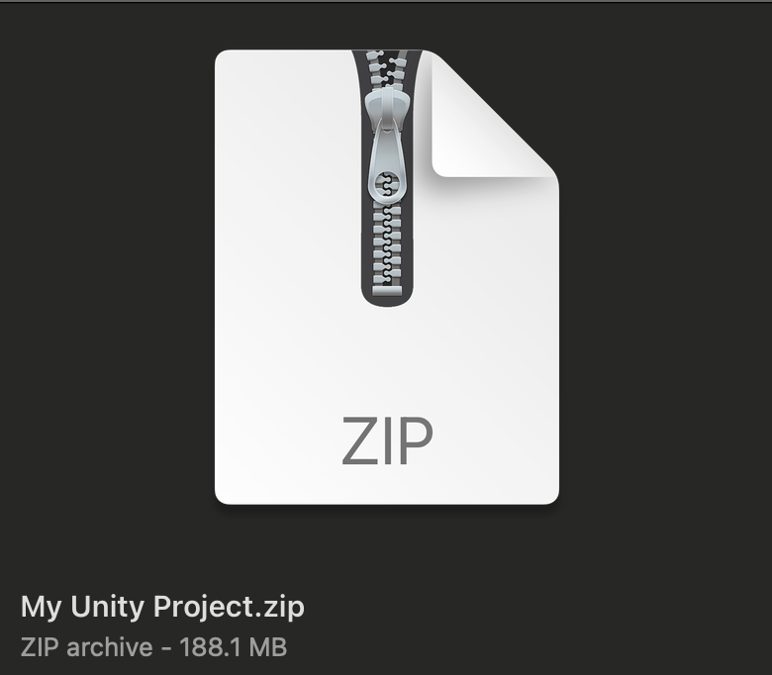
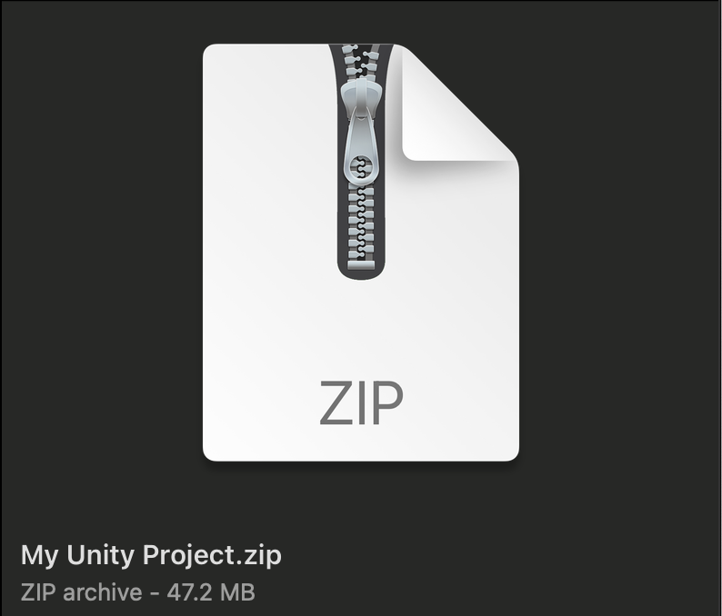
Compact File Size
(temporary files not included)

Slide 6
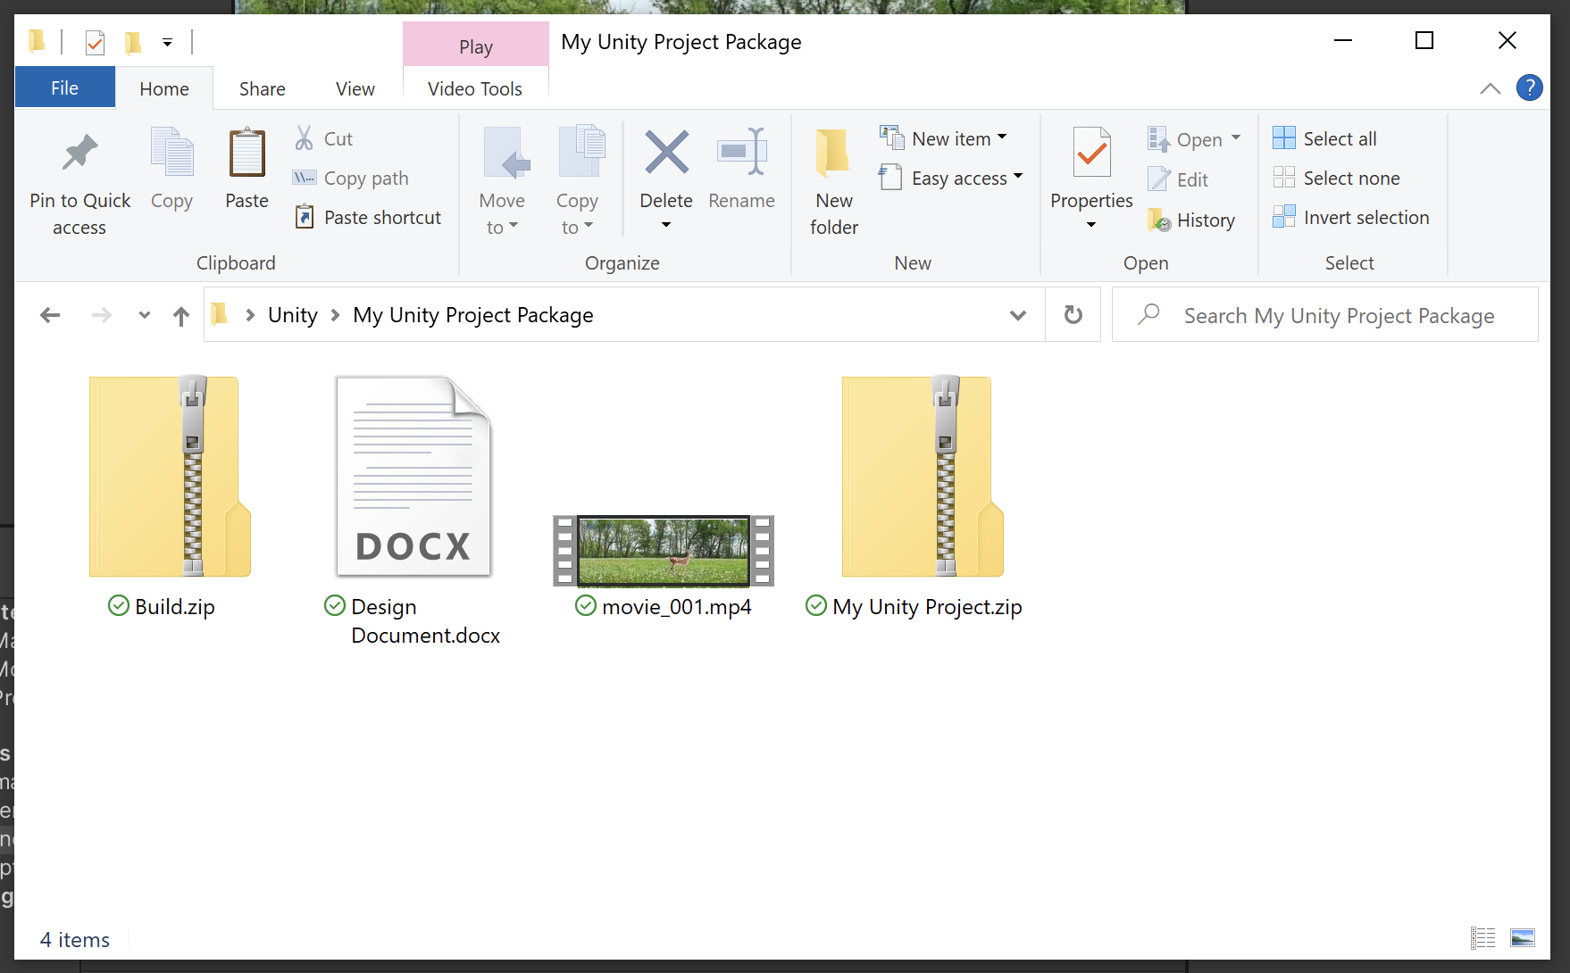
Runs on Windows and Mac
(not tested on Linux but should work)

Slide 7
Publish For Submission

Slide 8
Publish For Submission

